Slide 1

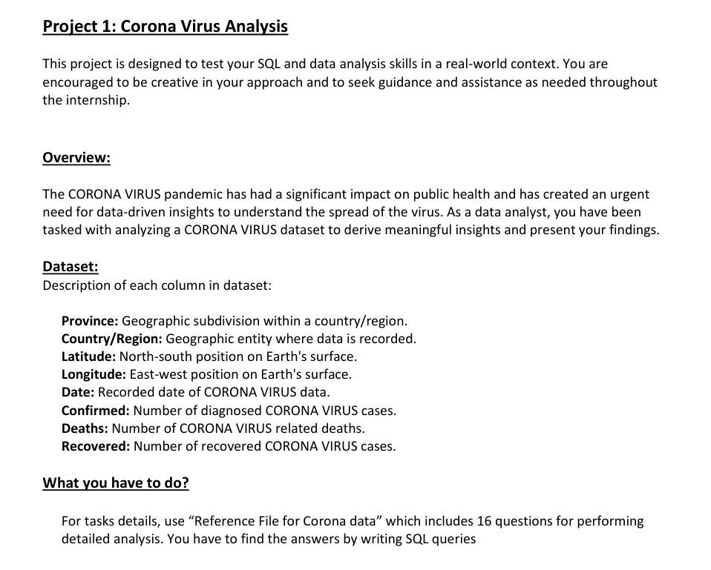
Corona-Virus Finding Through MS- SQL

Slide 2

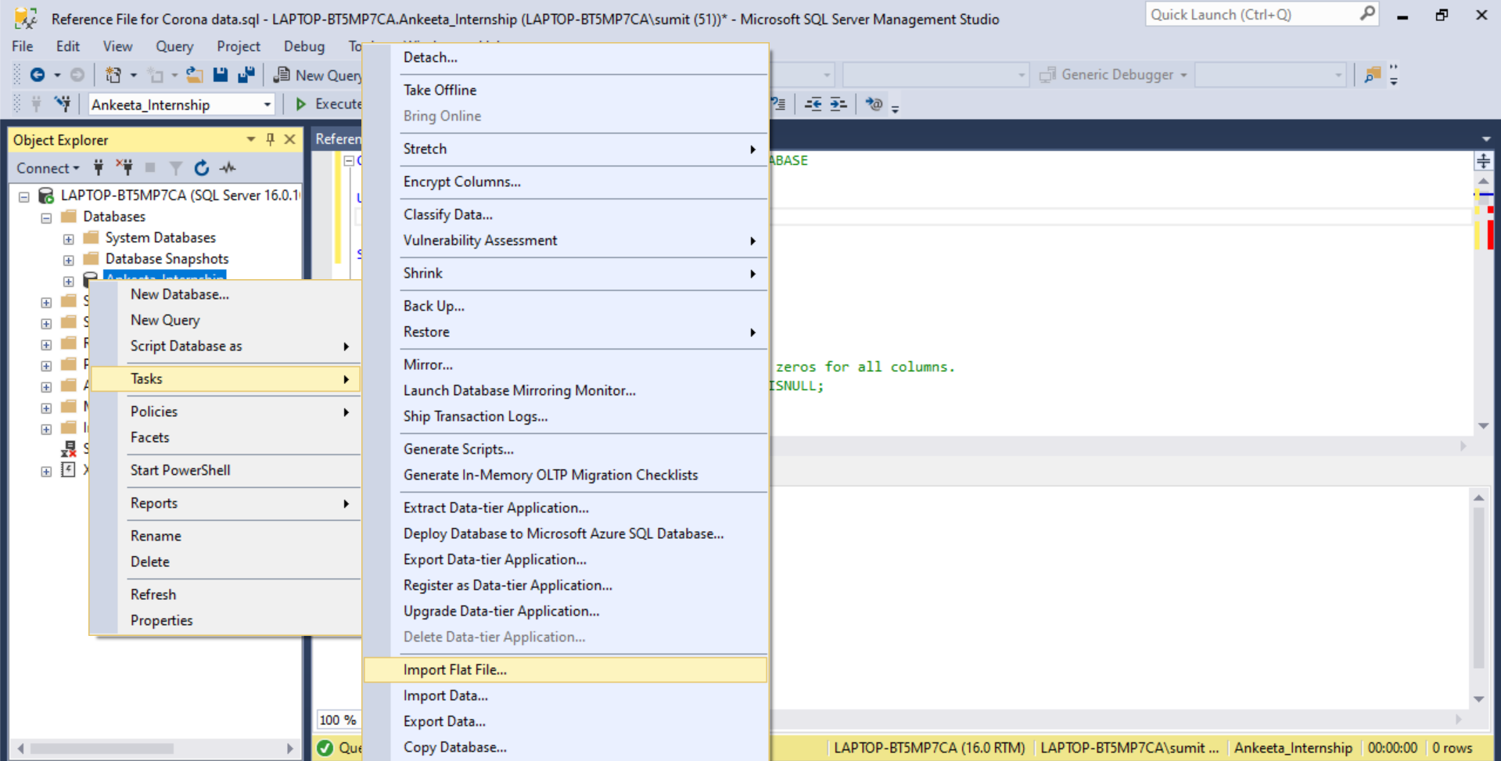
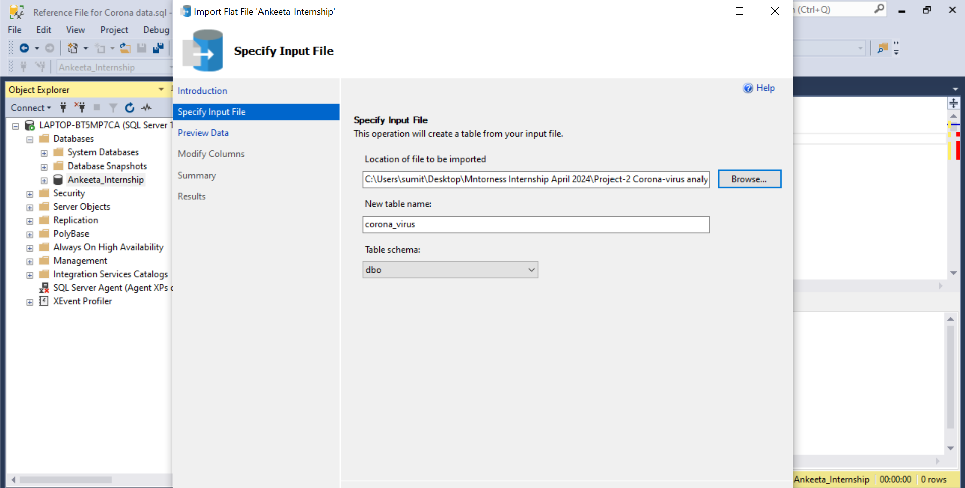
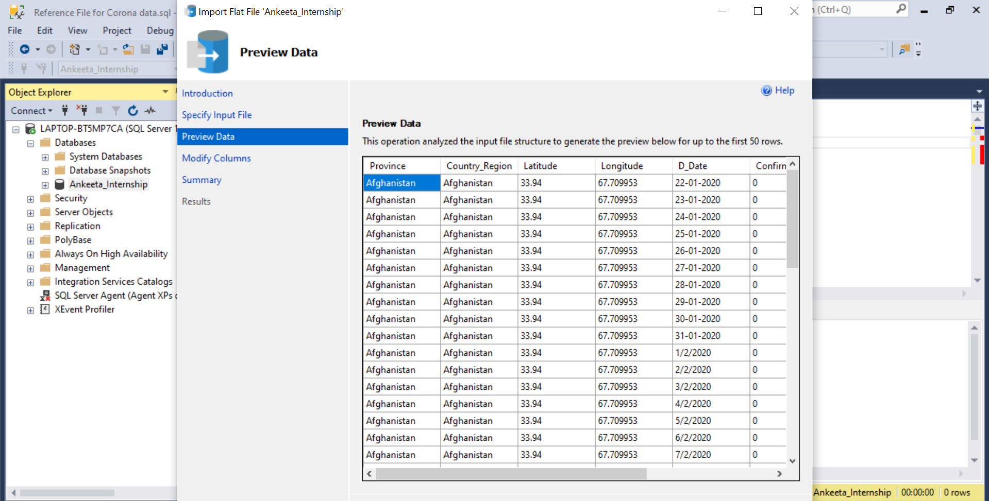
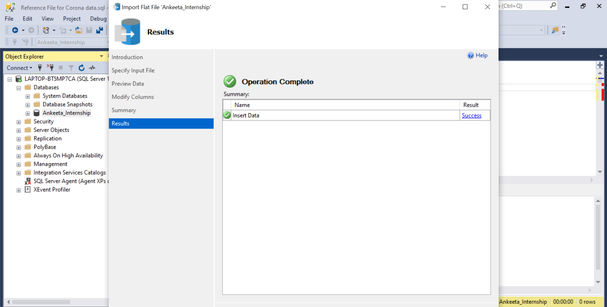
Steps for Importing Dataset in MS SQL
1
2
How to import files ?
3
4

Slide 3

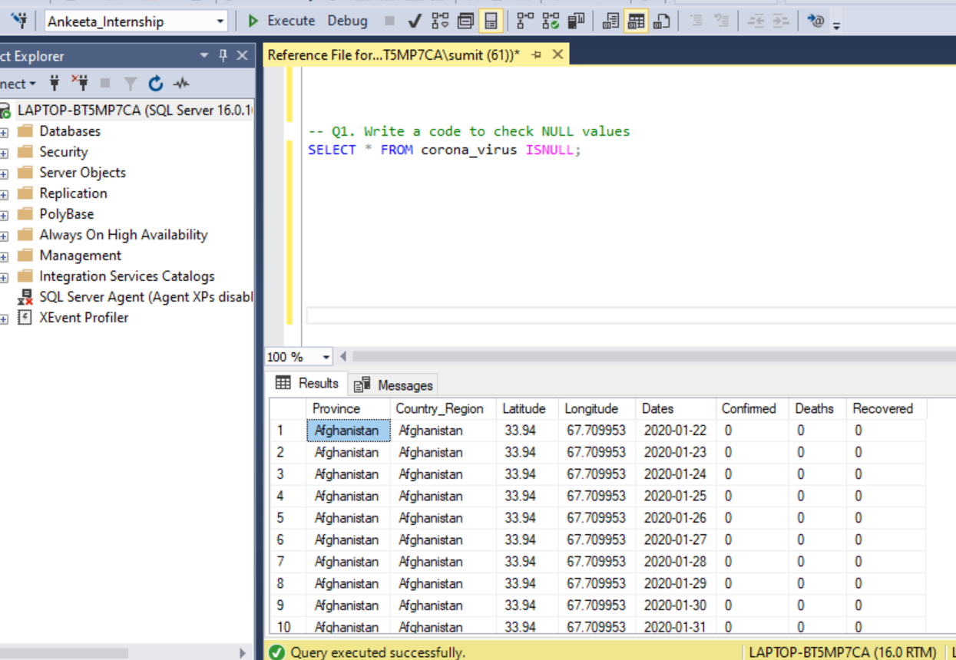
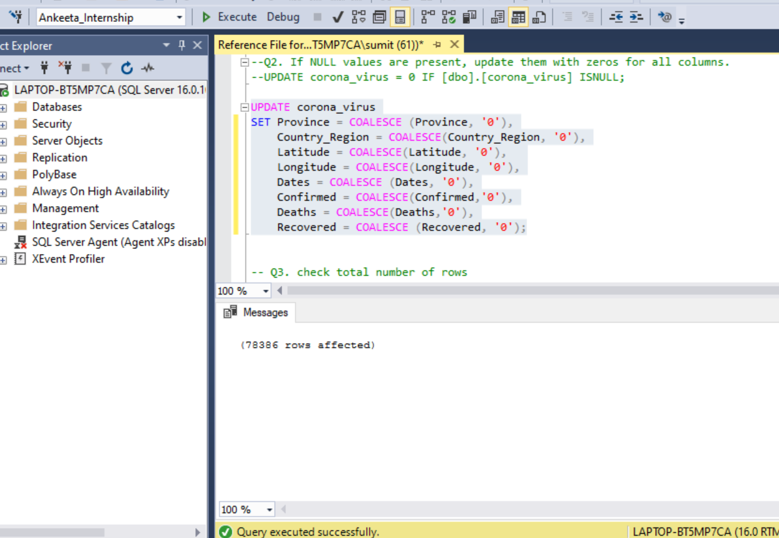
Cleaning Dataset – Checking for Null Values and Updating
How to find the Null Values and Update the Null Values with “0”
1
2

Slide 4
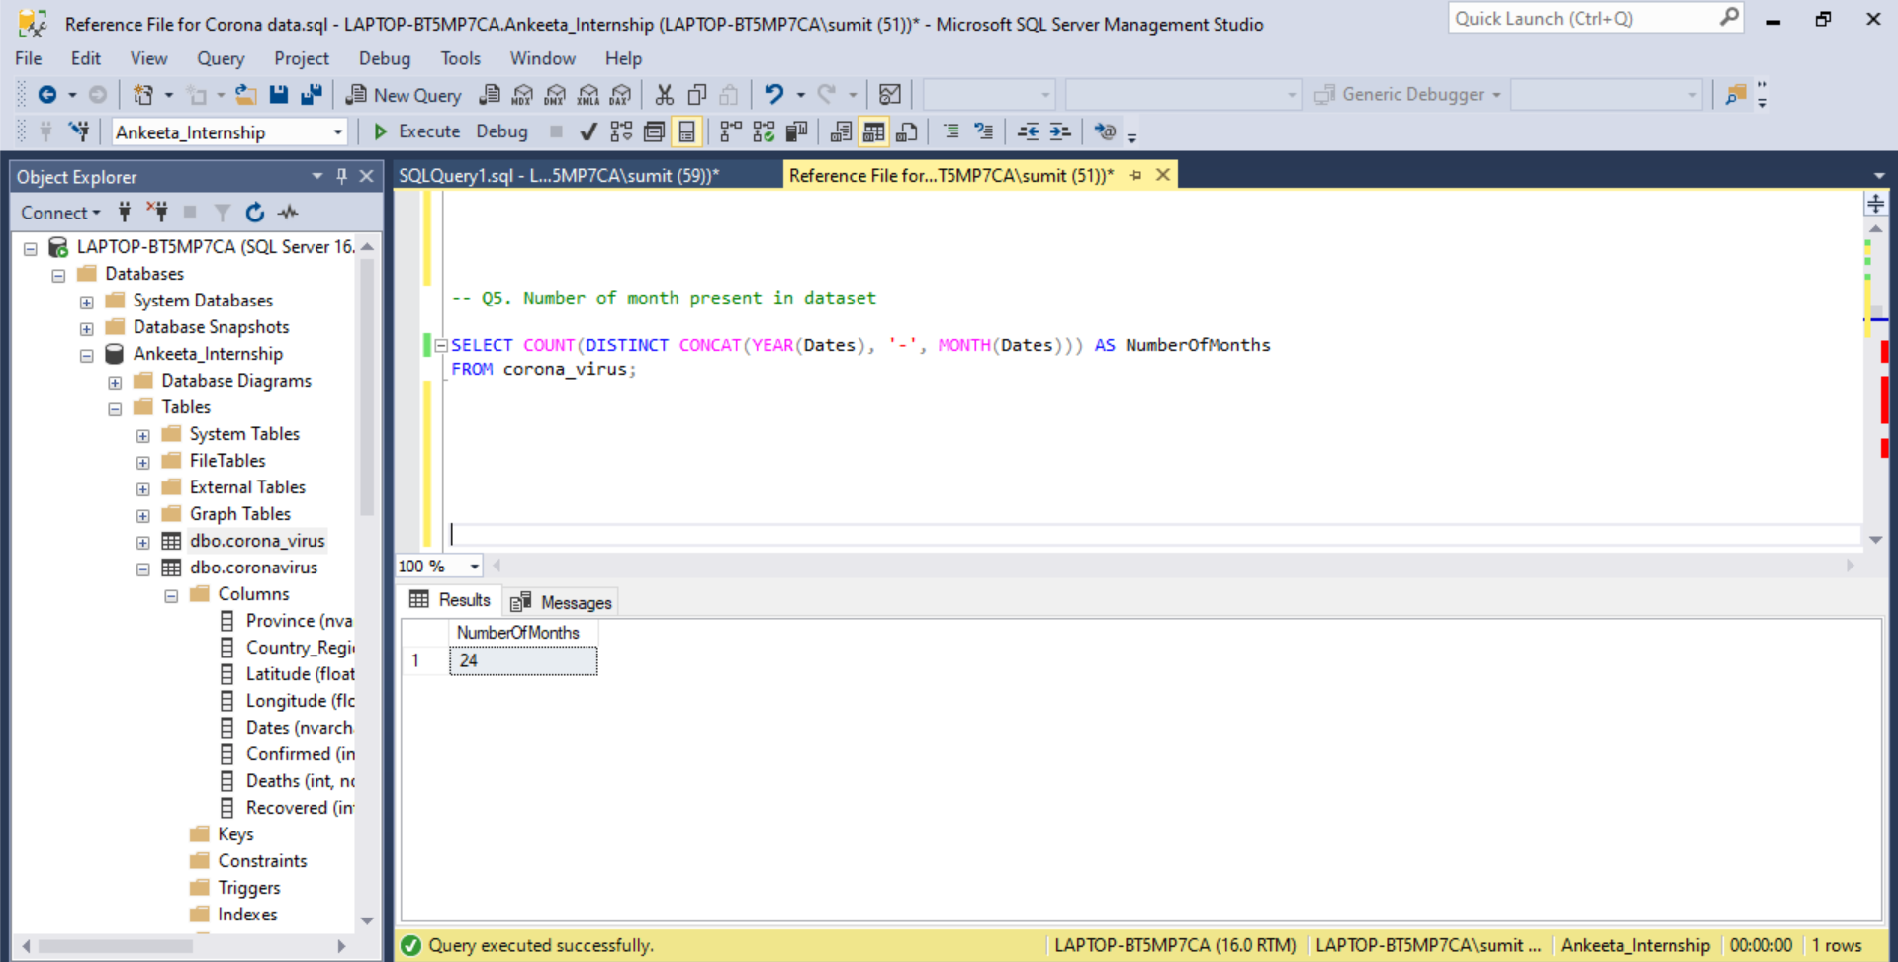

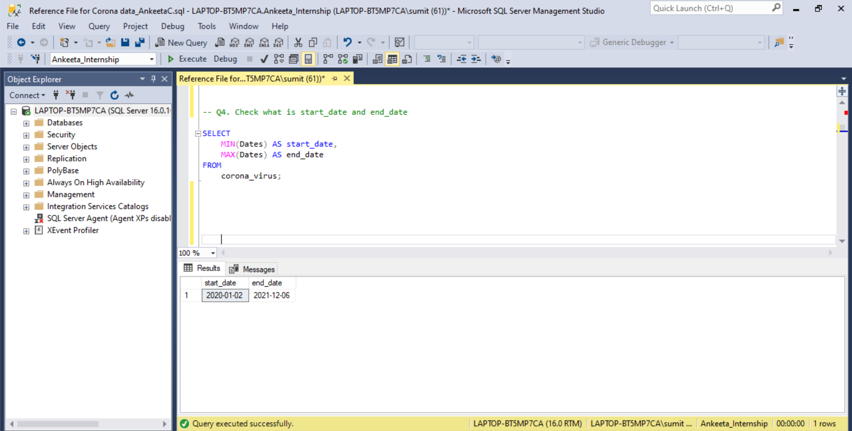
As per Dataset Covid Started on January 2020 & Ended on December 2021 (24 Months Period)
What is the start date and the end date?

Slide 5
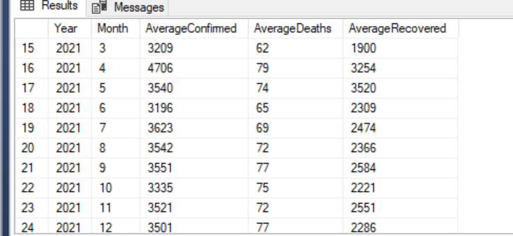

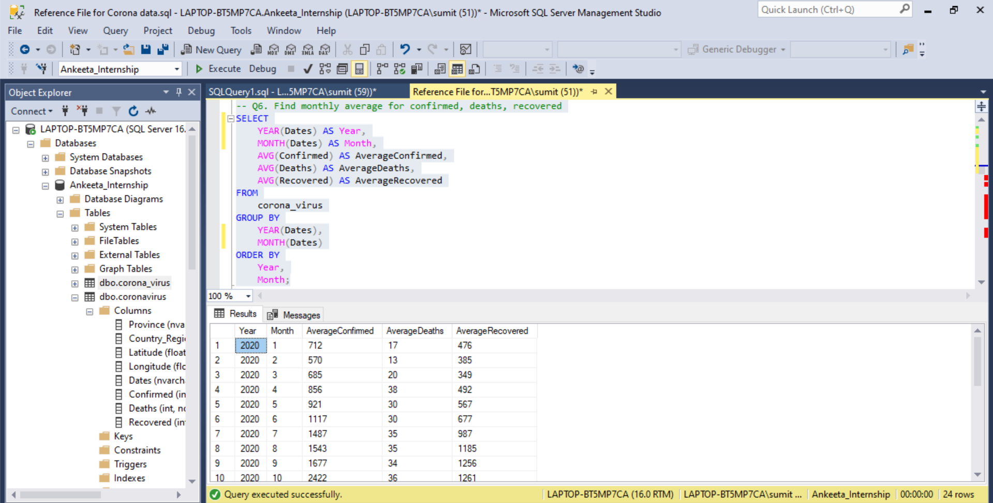
With Time-Period as Confirmed cases increased there was increase in Recovery cases
What are the average confirmed, recovery and death cases month wise?
Monthly average for confirmed, Recovery and Death Cases

Slide 6
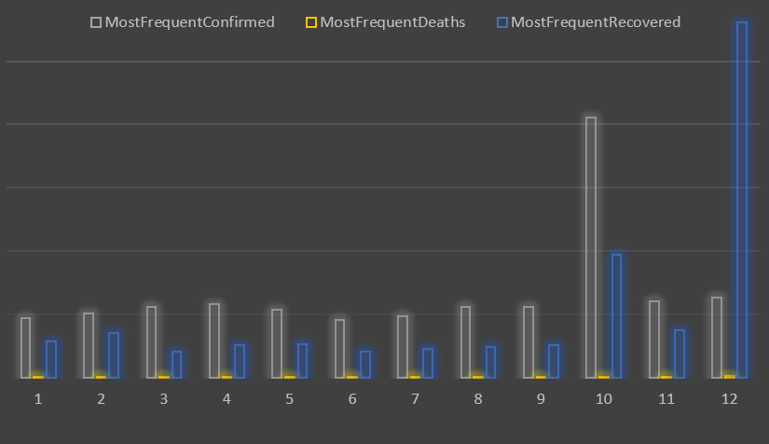

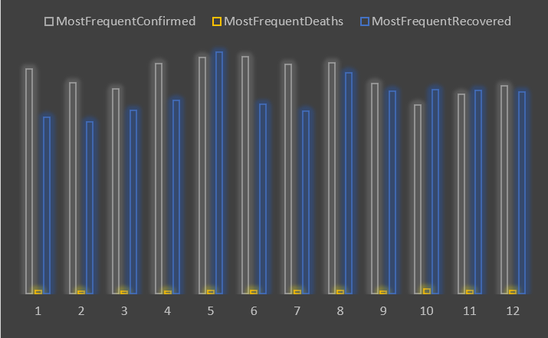
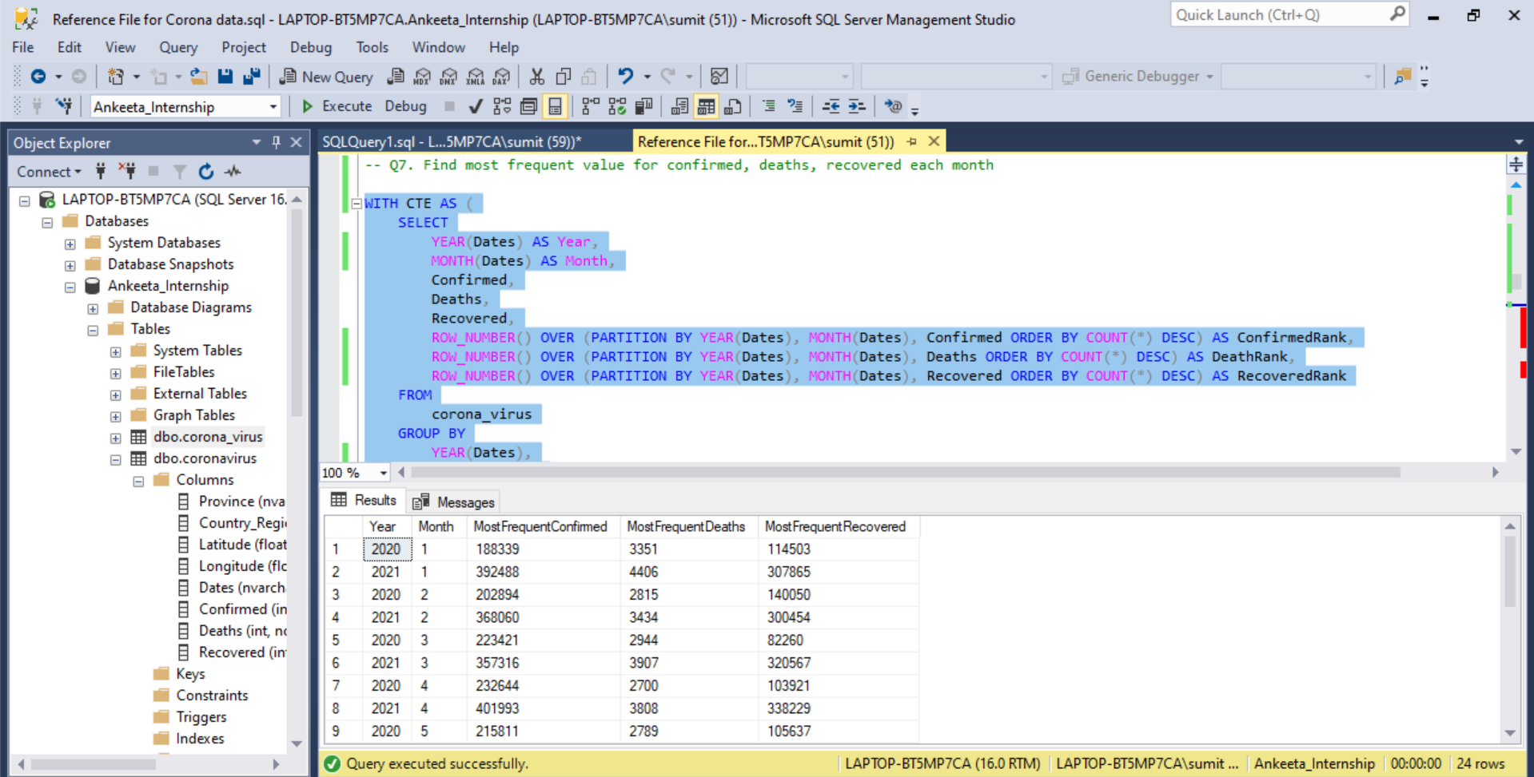
October and December 2020 shows peak in confirmed cases, deaths and recovery.
What is the most frequent confirmed, death and recovered cases each month?
2020
Recovery shows large fluctuations over year due to increase in medical care, testing capacity, and vaccines.
Months
2021
Months

Slide 7

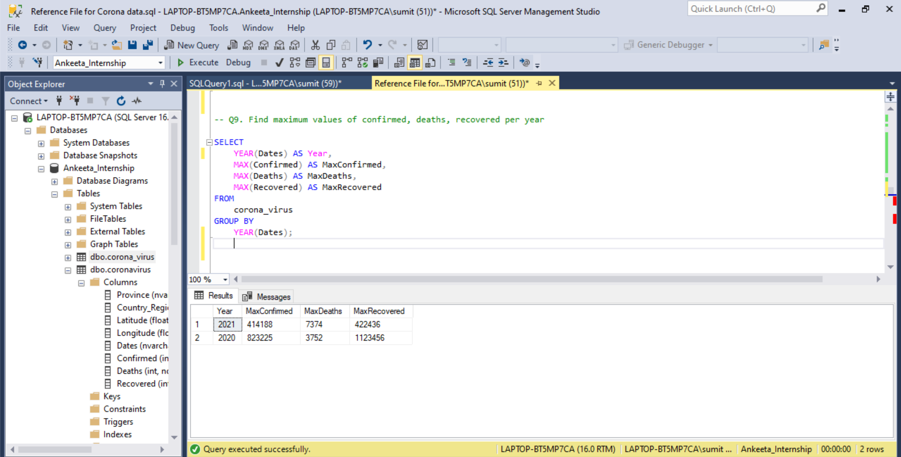
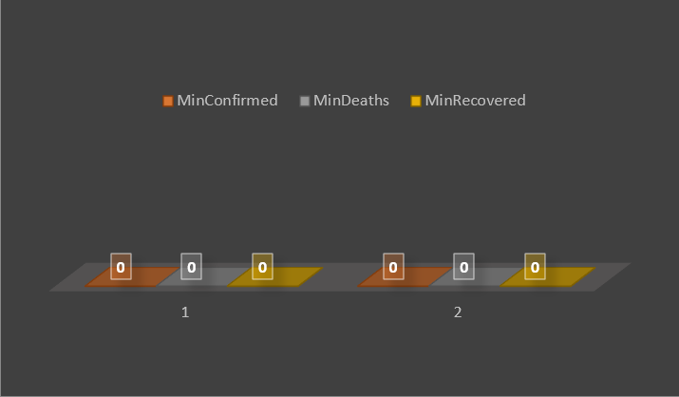
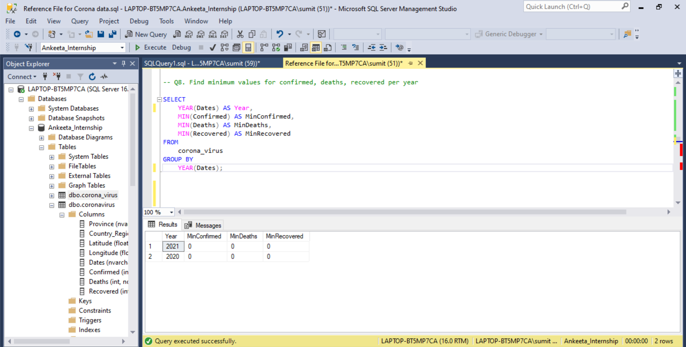
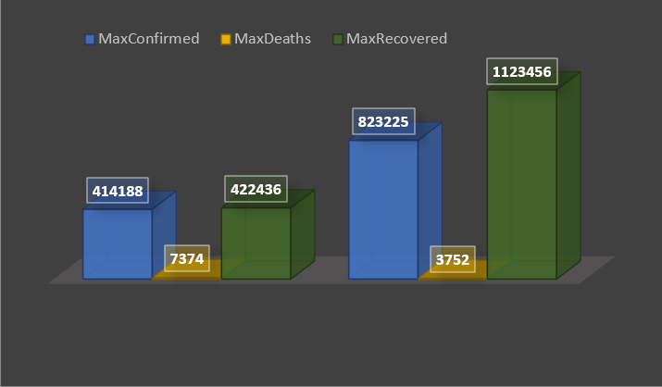
What is the minimum and maximum confirmed, deaths & recovery cases per year?
2020
2021
Year
Minimum Confirmed, Deaths & Recovered Cases per Year
2020
2021
Year
Maximum Confirmed, Deaths & Recovered Cases per Year

Slide 8
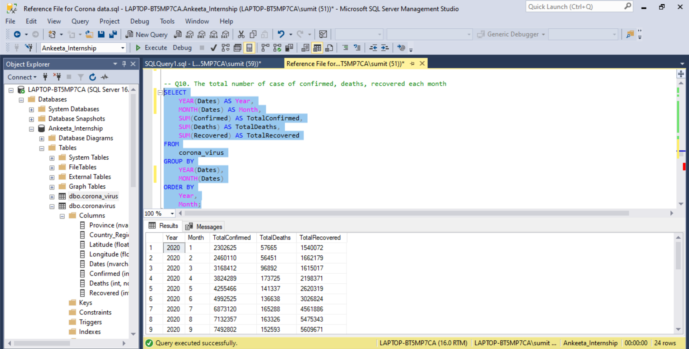

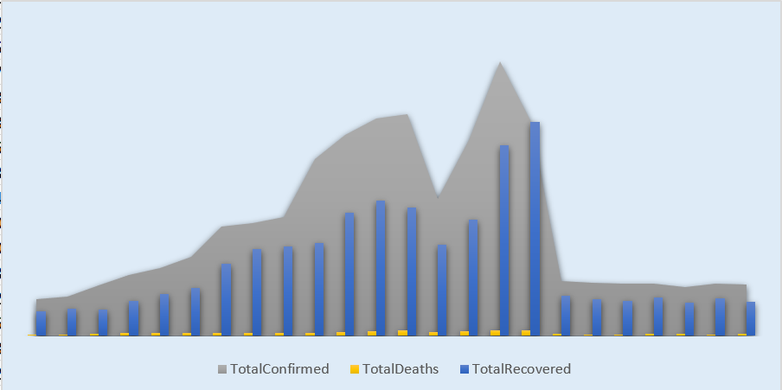
Total number of case confirmed, deaths and recovered each month
What is the total no. of confirmed, deaths and recovery each month?
April 2021
As looking into data, we can say that in
April 2021 has highest no. of Confirmed cases, while highest Death rate was December 2020 and highest Recovery rate was found in May 2021
May 2021
December 2020

Slide 9

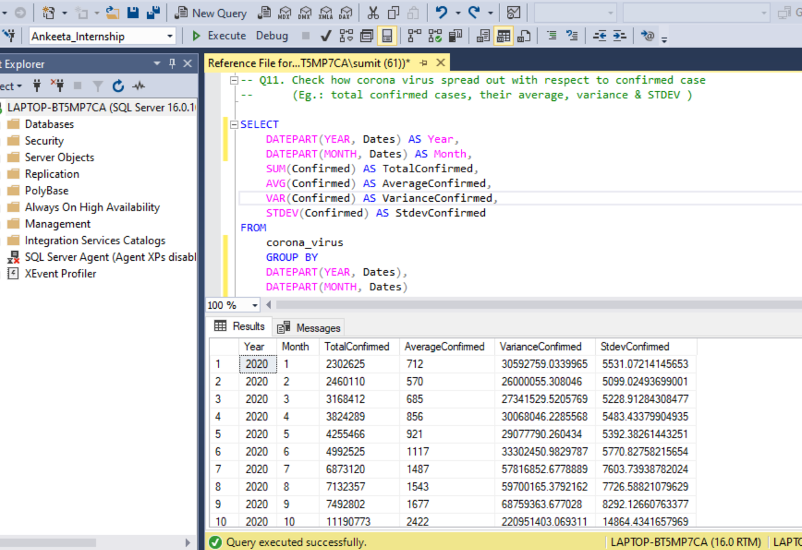
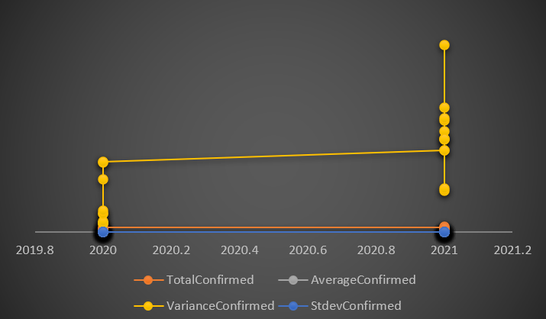
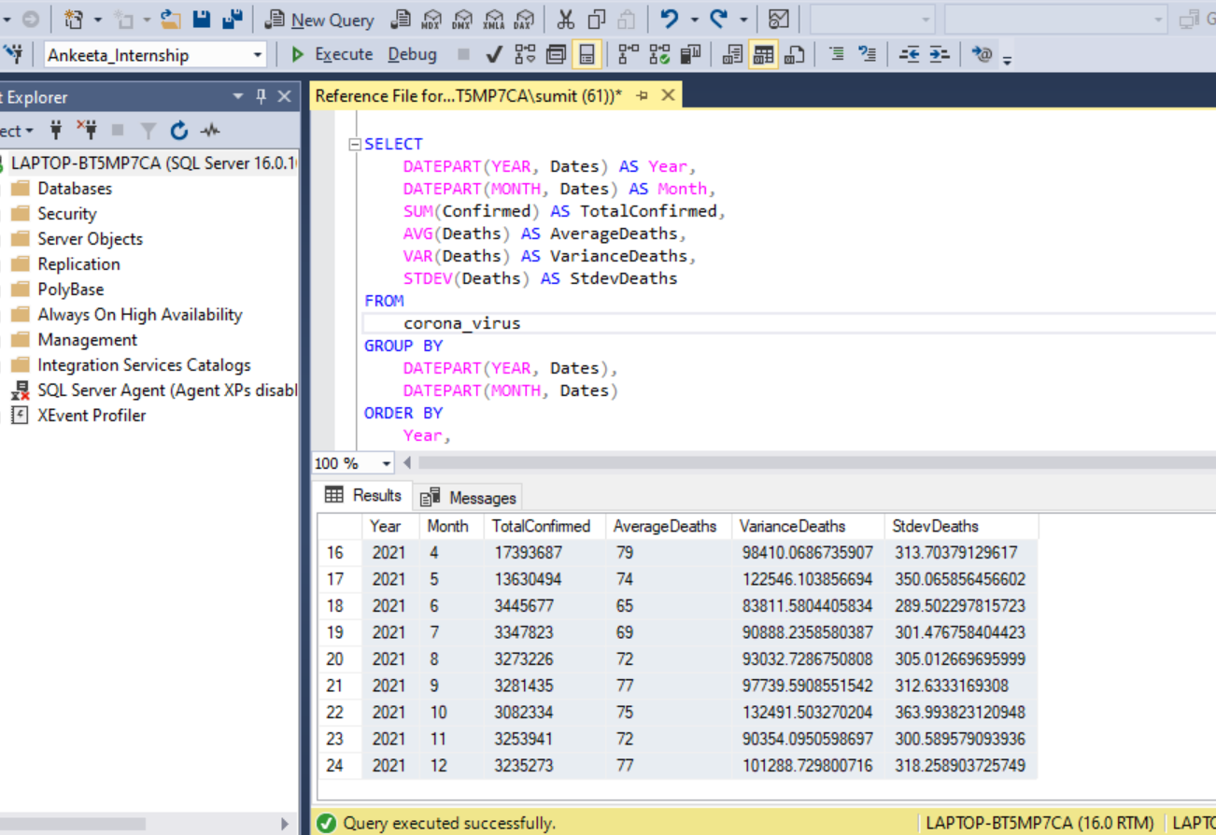
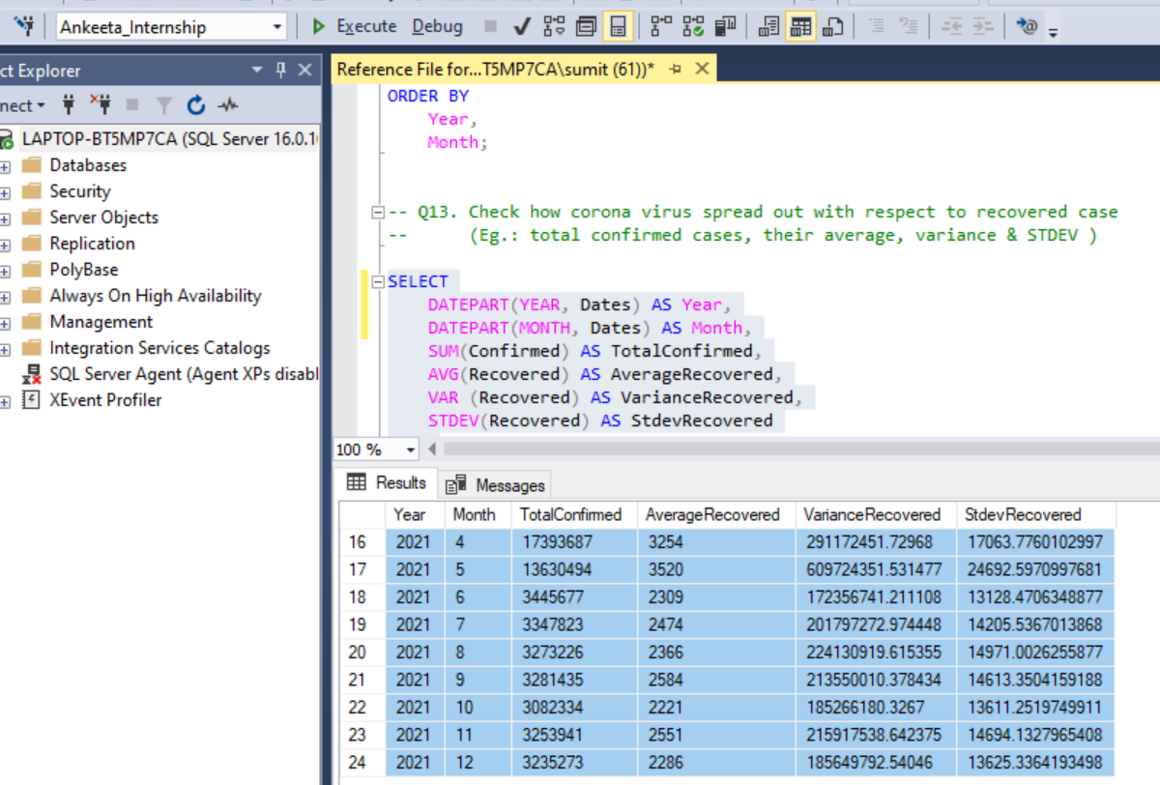
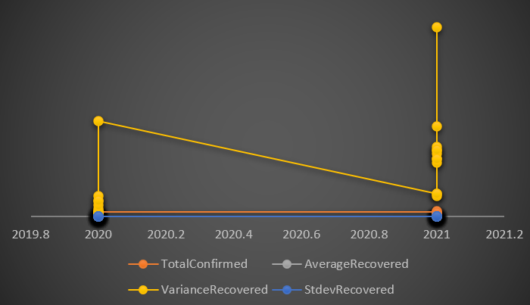
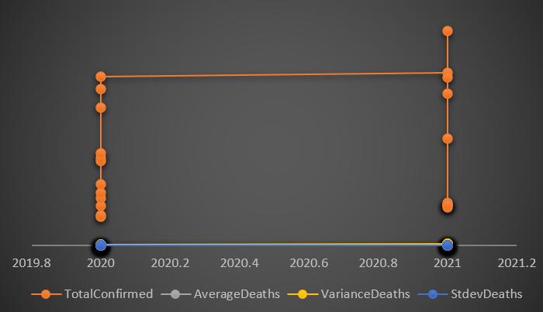
Data highlights the widespread nature of the Corona Virus with Time Period
Check how corona virus spread out with respect to confirmed, death & recovered case

Slide 10
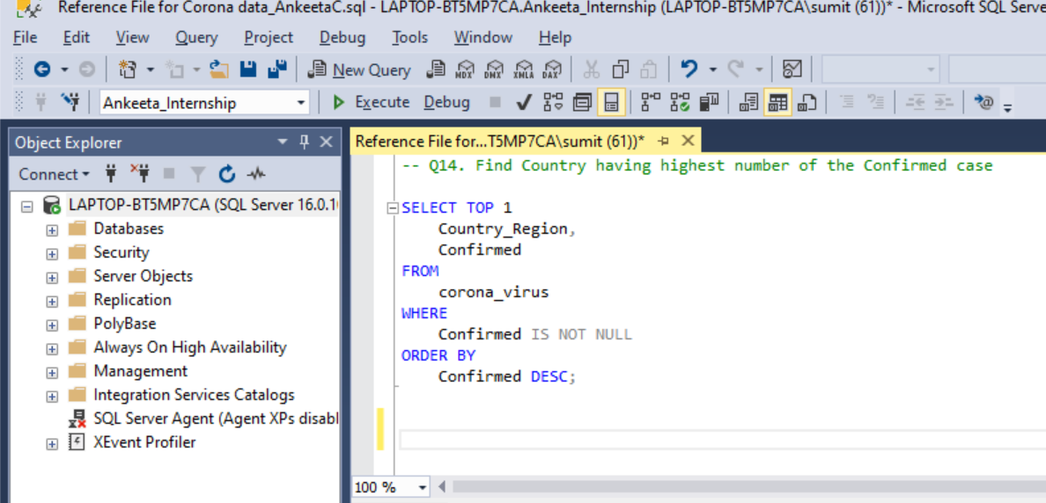

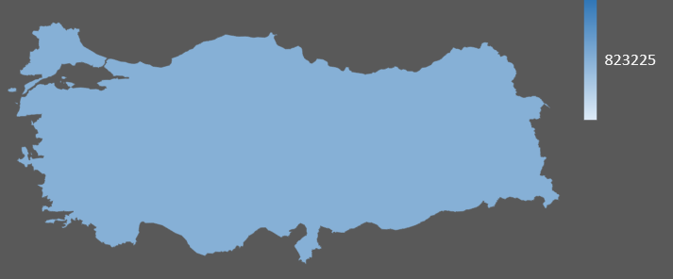
Country with Highest Confirmed Cases
Find the country with highest confirmed cases?
Turkey

Slide 11
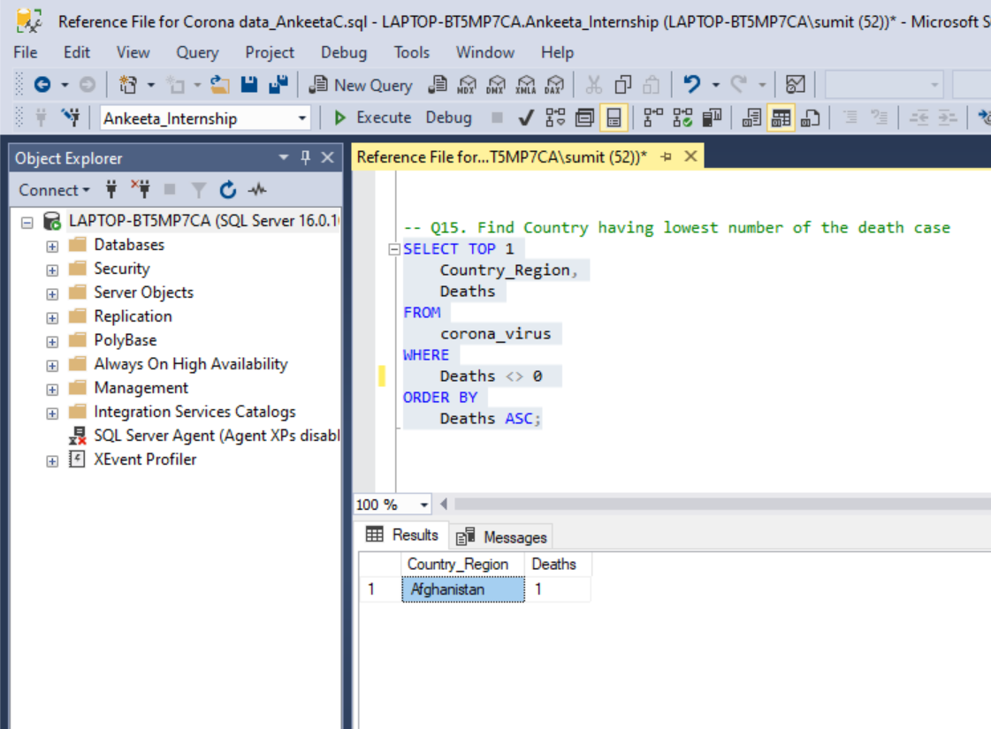
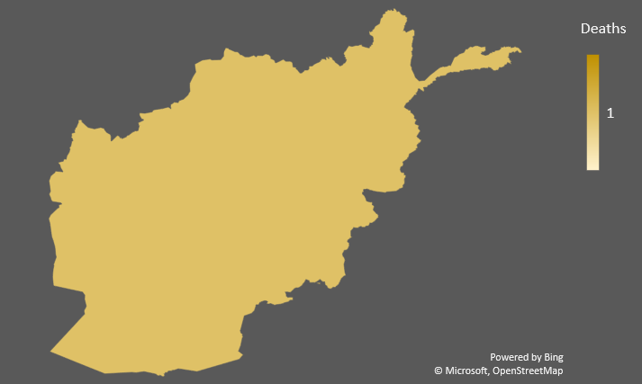
Country with Lowest Death Rate
Find the country with lowest death rates?
Afghanistan

Slide 12
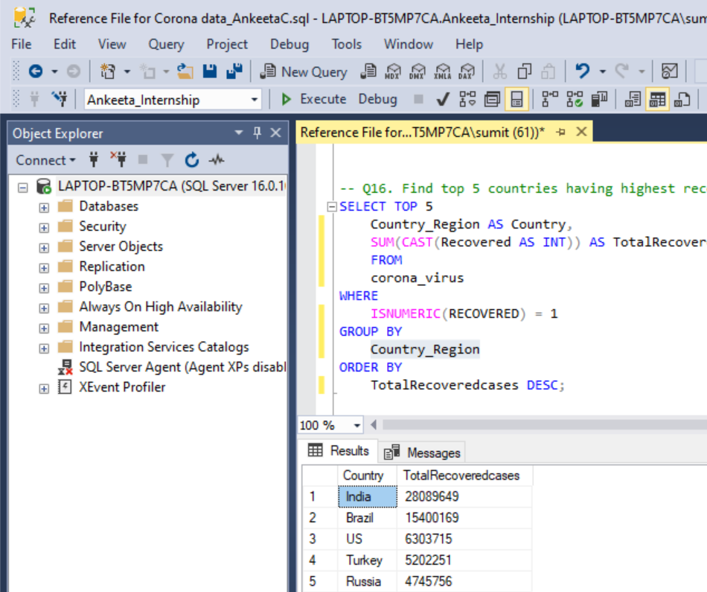
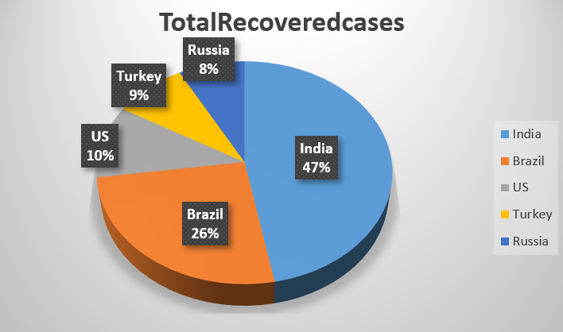

Top 5 Countries with Recovery rate
Find top 5 countries with highest recovery rate

